Slide 1
视频压缩技术基础
浙江大学计算机学院
杨洋
yangya@zju.edu.cn

Slide 2
Outline
Introduction to video compression
Lossless Compression Algorithms
Lossy Compression Algorithms

Slide 3
1. Introduction to Video Compression

Slide 4
Introduction
Why we need video compression?
  Uncompressed video data could be extremely large
  Pose some problems for network communication
  High-Definition Television (HDTV)
    1920x1080
    30 frames per second (full motion)
    8 bits for each three primary colors
  → Total 1.5 Gb/sec!
  Each cable channel is 6 MHz
    Max data rate of 19.2 Mb/sec
    Reduced to 18 Mb/sec w/audio + control …
  → Compression rate must be 83:1!

Slide 5
Why are Videos Compressible
Statistical redundancy or structure in the data (spatial, temporal, spectral)
Existence of perceptually irrelevant information

Slide 6
Throwing away some information
Redundant Spatial Information
Redundant Temporal Information
Color Information

Slide 7
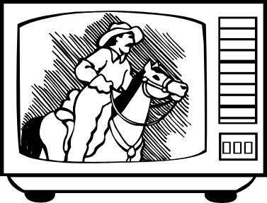
Spatial Information
European broadcast TV standard
Resolution is reduced to 352 (width) by 288 (height) pixels
  Source Input Format (SIF)
625 Half-lines
417 lines
288 pixels
352 pixels

Slide 8
Color
Human perception is most sensitive to luminance (brightness) changes
Colour is less important e.g. a black and white photograph is still recognisable
RGB encoding is wasteful – human perception tolerates poorer colour.
Use YUV and only encode chrominance (UV) at half resolution in each direction (176 by 144) – Quarter SIF). This gives 0.25 data for U and V compared to Y.

Slide 9
Throwing away color
After throwing away all this information, we still have a data rate of (assuming 8 bits per YUV):
  Y = (352*288) * 25 * 8 = 20.3 Mb/s
  U = (352/2 * 288/2) * 25 * 8 = 5.07 Mb/s
  V = (352/2 * 288/2) * 25 * 8 = 5.07 Mb/s
  TOTAL (for video) = 30.45 Mb/s
  MPEG 1 audio runs at 128Kb/s
  Video CD - Target is 1.5Mb/sec
  Space for video = 1.5 – 0.128Mb/s = 1.372Mb/s
So now use compression to get a saving of 22:1

Slide 10
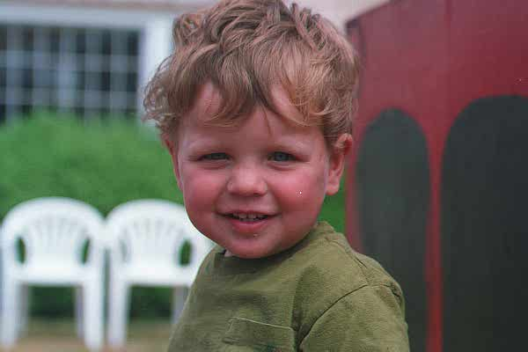

Temporal Information
Feasibility of video compression
  Frames in the same scene are very similar, so video data have temporal redundancy
  Even static images can be compressed at large compression ratio, say nothing of video
Spatial + Temporal redundancy

Slide 11



Temporal Information
950
951
952
temporal redundancy

Slide 12
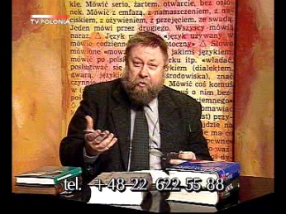
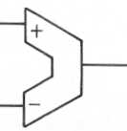
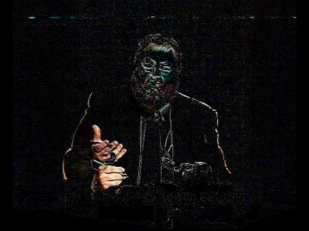
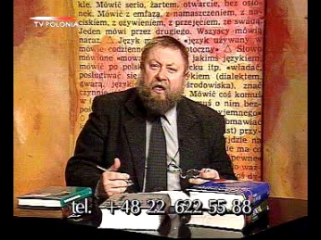
Temporal Reduancy
Video is a sequence of images stacked in the temporal dimension
The most simple method: Predictive Coding
  Subtract images in time order
  Code the residual error

Slide 13
2. Lossless Compression Algorithms

Slide 14

Data Compression Scheme

Slide 15
Run-length Coding
In run-length code, runs of data (the same data value that occurs in many consecutive data elements) are stored as a single data value and count.
Example:
  Original data:
  Its run-length code:
WWWWWWWWWWWWBWWWWWWWWWWWWBBBWWWWWWWWWWWWWWWWWWWWWWWWBWWWWWWWWWWWWWW
12W1B12W3B24W1B14W

Slide 16


Run-length Coding Example
Compression rate: 98.1%!

Slide 17


Run-length Coding Example
Not that good

Slide 18
Predictive Coding
Prediction Model
Input data
Predicted value
Reconstruction = Prediction + Prediction Error

Slide 19
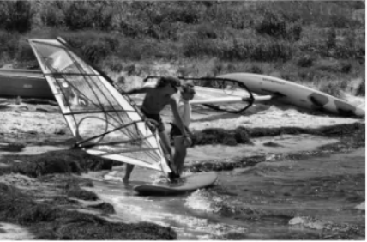
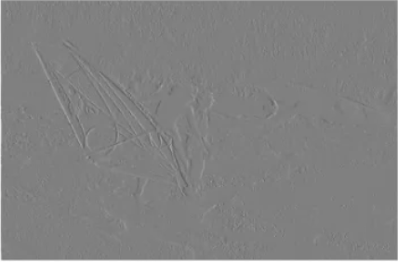
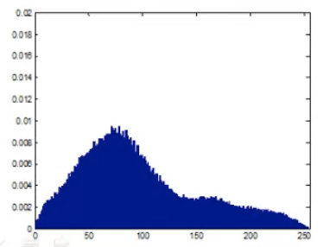
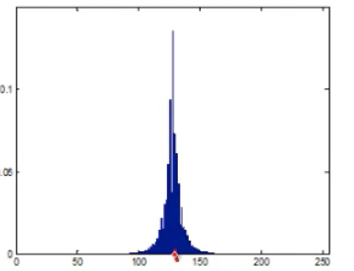
Predictive Coding
Predicted value of x(n):
y(n) = x(n-1)
Prediction error:
e(n) = x(n) - y(n)
= x(n) - x(n-1)

Slide 20
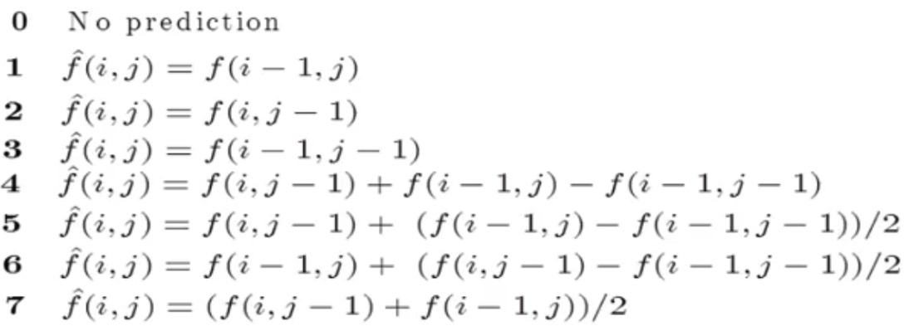
JPEG-LS Predictors
Prediction error is encoded by adaptive arithmetic coding

Slide 21
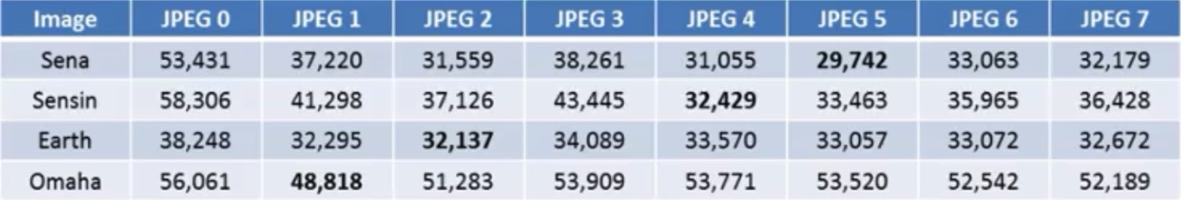
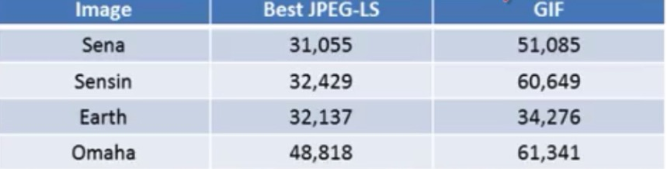
JPEG-LS Examples
Compressed file size in bytes of the residual images obtained using the various JPEG prediction models
Comparison of the file sizes obtained using JPEG lossless compression and GIF

Slide 22
Difference Coding
Difference coding assumes frames have few changes in adjacent time stamps.
It uses the difference between the frame at time t and the frame at t-1 as the prediction model.

Slide 23
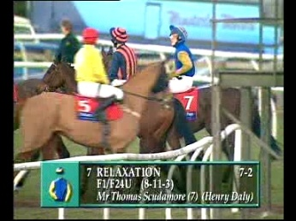
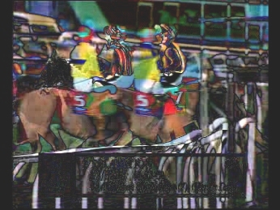
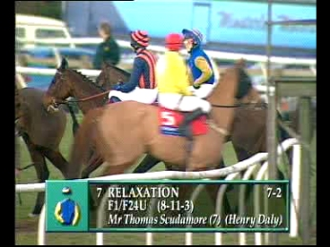
Difference Coding
Difference coding is good, but often an object will simply change position between frames.
DCT coding not as good as for ‘sparse’ difference image.

Slide 24
Huffman Coding (1951)
Symbols that occur more often will have the shorter codes
Procedure:
  Sort the symbols according to occur probability
  Combine the least probability symbols to form a composite symbol, with probability equal to the sum of the respective symbol probabilities
  Repeat procedure for remaining symbols
  Extract the codes from the resulting binary tree representation of the code

Slide 25
Huffman Code Example
Symbol | Prob.
s₁ | 0.2
s₂ | 0.4
s₃ | 0.2
s₄ | 0.1
s₅ | 0.1

Slide 26
3. Lossy Compression Algorithms

Slide 27
Introduction
• Lossless compression algorithms do not deliver compression ratios that are high enough. Hence, most multimedia compression algorithms are lossy.
• What is lossy compression?
  – The compressed data is not the same as the original data, but a close approximation of it.
  – Yields a much higher compression ratio than that of lossless compression.

Slide 28
Content
Basic Idea of Transform Coding
Discrete Cosine Transform (DCT)
Some Examples

Slide 29
Basic Idea
According principles of information theory
  Coding vectors is more efficient than coding scalars
  Need to group consecutive samples from input into vectors
Let X=｛x₁,x₂,…,x_{k}｝be vector of samples, there’s an amount correlation among neighboring.
If Y is the result of a linear transform T of the input vector and its components have much less correlation, then Y can be coded more efficiently than X.
  The transform T itself does not compress any data.
  The compression comes from the processing and quantization of the components of Y.
DCT is a widely used transform, it can perform de-correlation of the input signal.

Slide 30
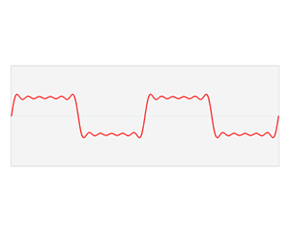
Fourier Transform
The Fourier transform (FT) decomposes a function of time (a signal) into the frequencies that make it up.
The Fourier transform is called the frequency domain representation of the original signal.

Slide 31

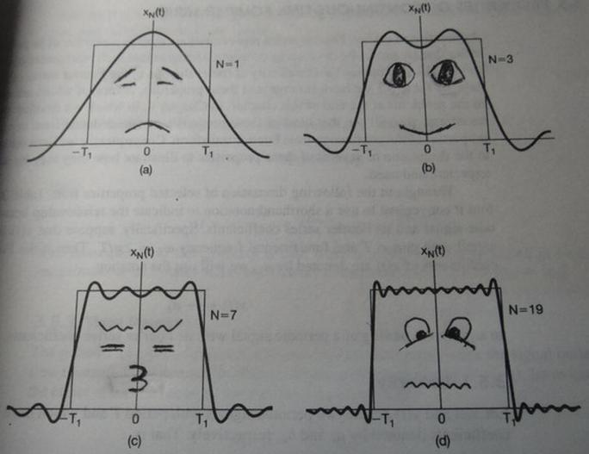
Fourier Transform

Slide 32
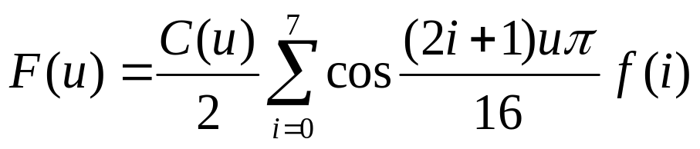
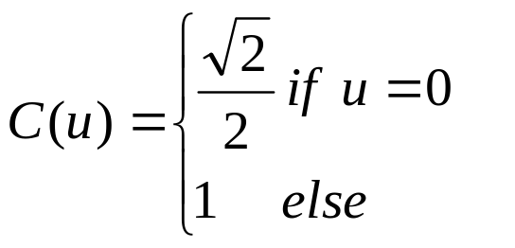
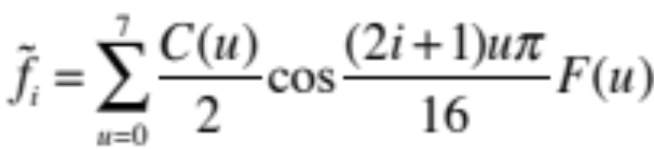
Discrete Cosine Transform (DCT)
1D Discrete Cosine Transform：
1D Inverse Discrete Cosine Transform:
2D transform can be used to process 2D signals such as digital images

Slide 33
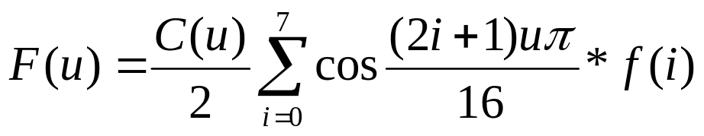
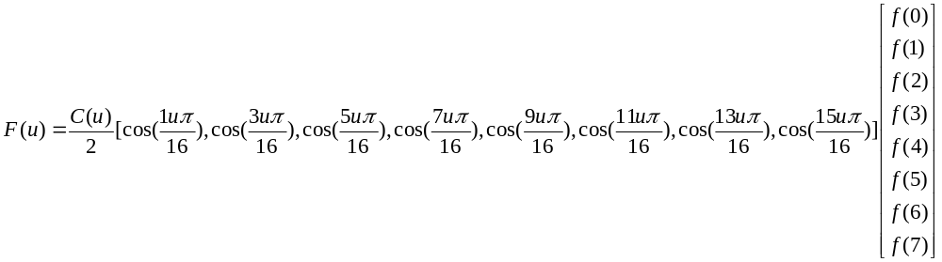
Discrete Cosine Transform (DCT)

Slide 34
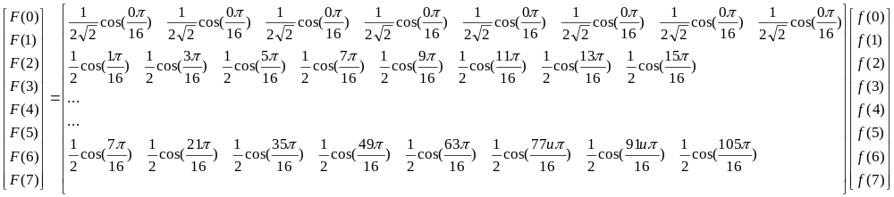
Discrete Cosine Transform (DCT)

Slide 35
Discrete Cosine Transform (DCT)
Basis Function: B_{i}
Basis: b_{i}

Slide 36
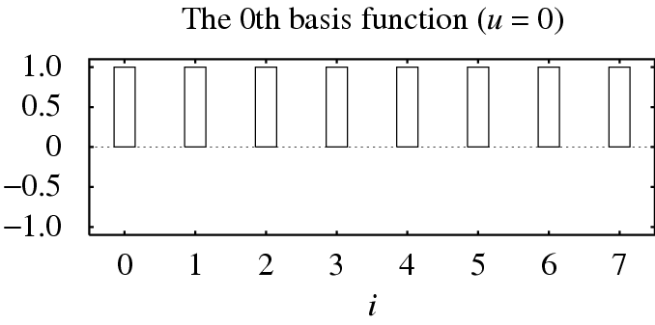
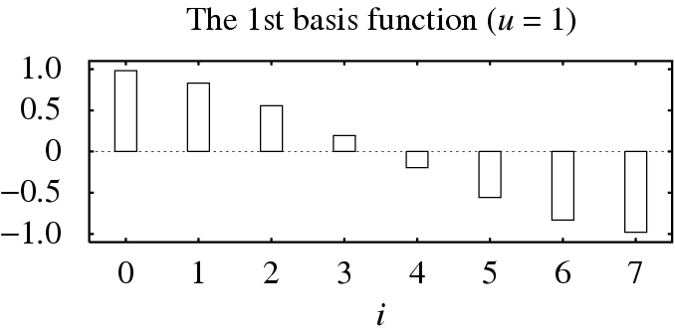
Discrete Cosine Transform (DCT)

Slide 37
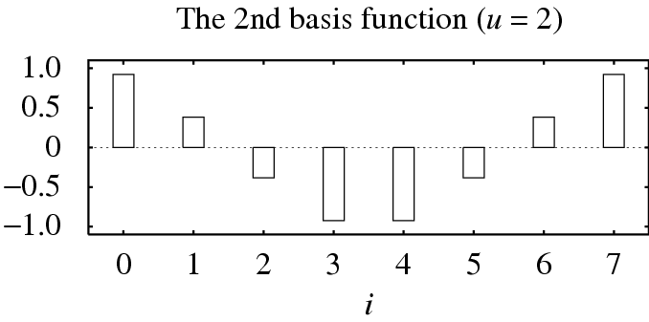
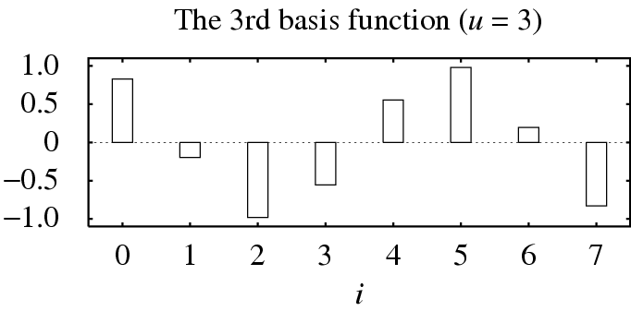
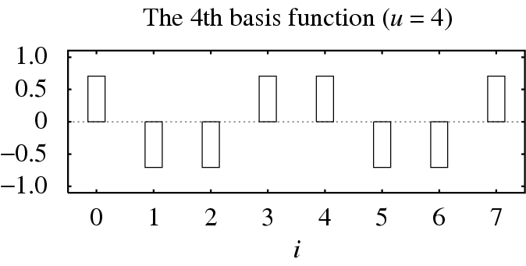
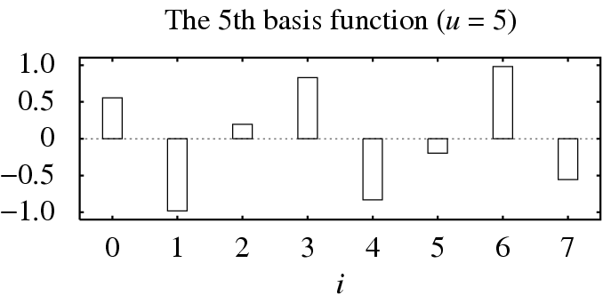
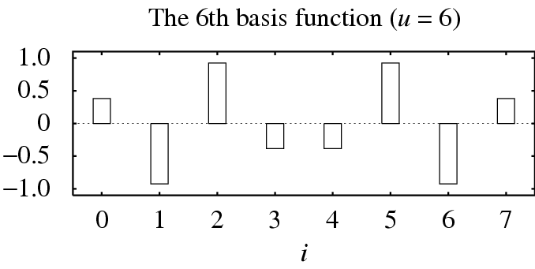
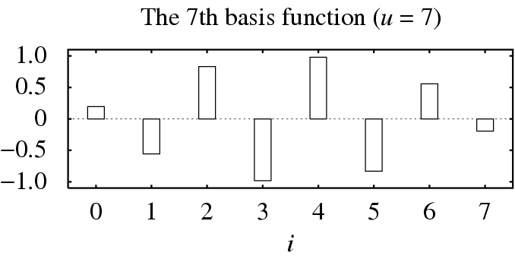

Slide 38
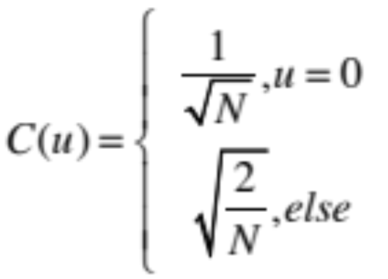
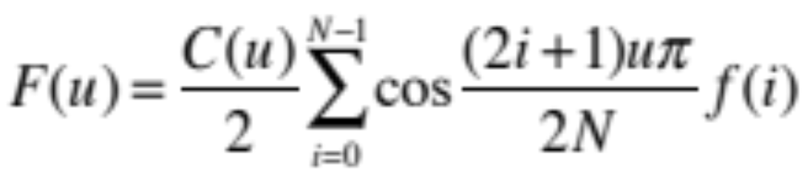
General Definition of DCT
General definition of DCT to transform N elements:

Slide 39
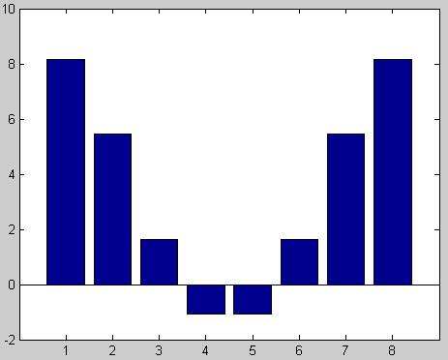
Example 1
Original data
  f(i) = [8.1549 5.4490 1.6221 -1.0839 -1.0839 1.6221 5.4490 8.1549]

Slide 40
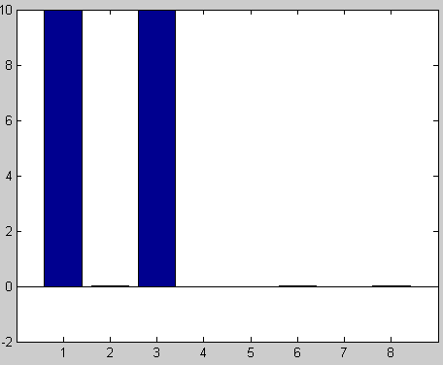
Example 1
F(u)=dct(f(i))
= [10.0000 0.0000 10.0000 -0.0000 0 0.0000 -0.0000 0.0000]

Slide 41
Example 1
f(i)
F(u)=dct(f(i))
f’(i)=i_dct(F(u))

Slide 42
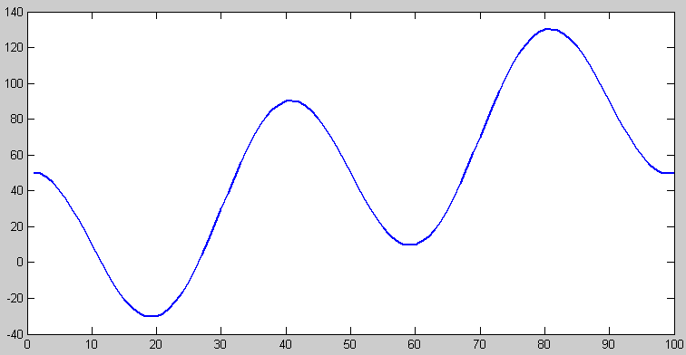
Example 2
Matlab simulation
  x = (1:100) + 50*cos((1:100)*2*pi/40);

Slide 43
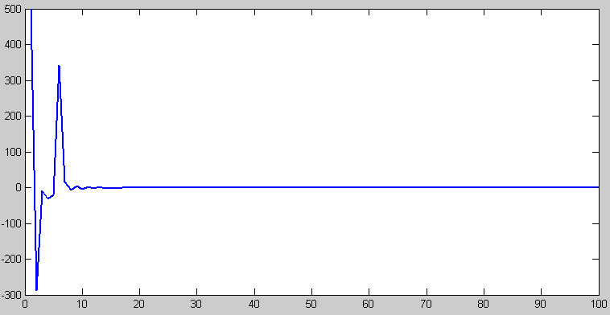
Example 2
  x_dct = dct(x);

Slide 44
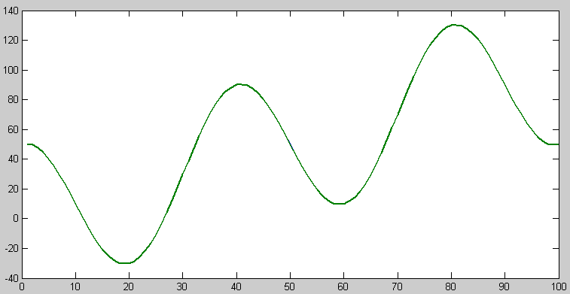
Example 2
y = idct(x_dct);

Slide 45
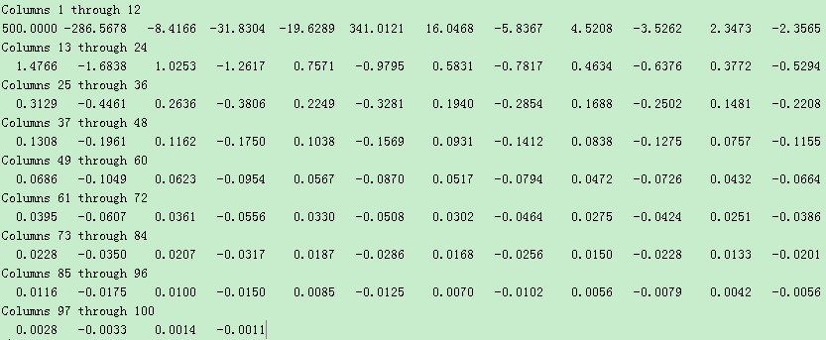
Example 2
x_dct

Slide 46
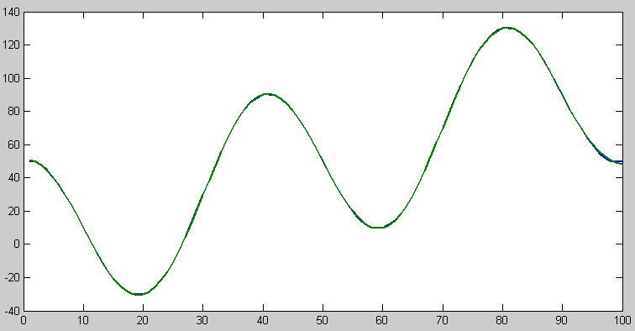
Example 2
  x_dct(16:100) = 0;
  z = idct(x_dct);

Slide 47
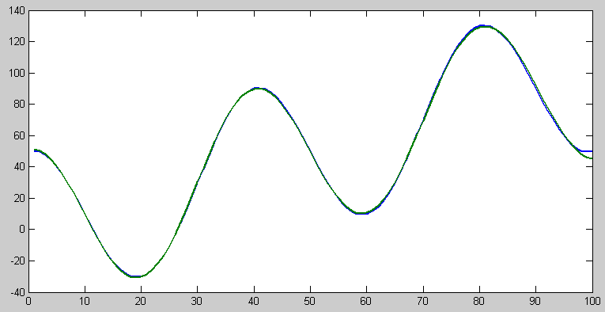
Example 2
  x_dct(8:100) = 0;
  z = idct(x_dct);

Slide 48
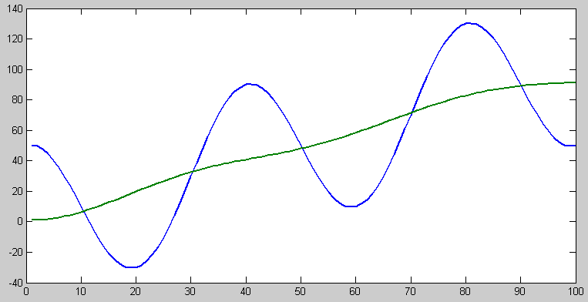
Example 2
  x_dct(6:100) = 0;
  z = idct(x_dct);

Slide 49
Discrete Cosine Transform (DCT)
Cosine basis are orthogonal
b_{i} * b_{j} = 0 if i~=j
b_{i} * b_{j} = 1 if i=j
Mathematics Meaning: Transform a vector from one linear space to another linear space

Slide 50

Example 3
DCT in 3D Space
P = [1,1,1]
=1*[1,0,0]+1*[0,1,0]+1*[0,0,1]
Dct(P)=[1.732,0,0]
e1 = [0.5774 0.5774 0.5774]
e2 = [0.7071 0.0000 -0.7071]
e3 = [0.4082 -0.8165 0.4082]
P = 1.732*e1+0*e2+0*e3
y, [0,1,0]
e1
1.732
[1,1,1]
z, [0,0,1]
x, [1,0,0]
e3
e2

Slide 51
Example
f(i)
F(u)=dct(f(i))
f(i) = [8.1549 5.4490 1.6221 -1.0839 -1.0839 1.6221 5.4490 8.1549]
F(u)=dct(f(i))
= [10.0000 0.0000 10.0000 -0.0000 0 0.0000 -0.0000 0.0000]
f(i) = 10*b₀+10*b₂

Slide 52
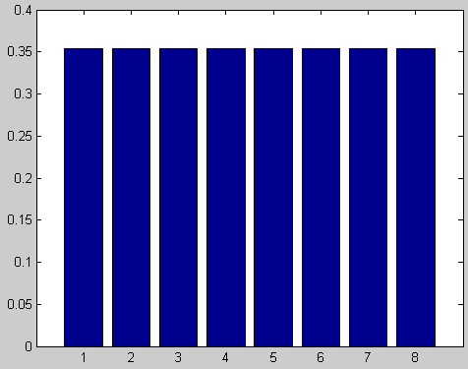
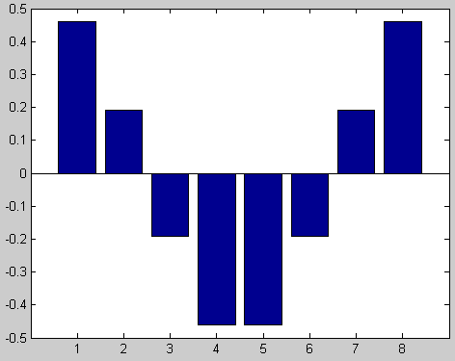
Example 4
*10 +
*10
b₀
=
b₂
f(i)

Slide 53
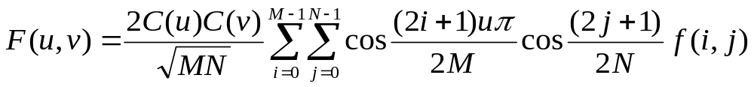
Discrete Cosine Transform (DCT)
DCT（2D）Definition：
  Given a function f(i, j) over an image，the 2D DCT transforms it into a new function F(u,v), integer u and v running over the same range as i and j.
  The general definition of the DCT transform is：

Slide 54
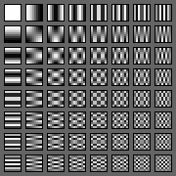
Discrete Cosine Transform (DCT)
2D Basis Functions

Slide 55
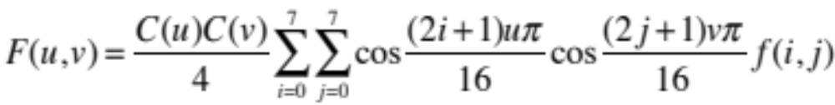
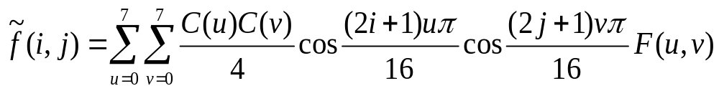
Discrete Cosine Transform (DCT)
In the JPEG image compression standard
  An image block is defined to have dimension M=N=8；
  The definition of 2D DCT and its inverse IDCT are as follows：
2D Discrete Cosine Transform(2D DCT)：
2D Inverse Discrete Cosine Transform(2D IDCT)：

Slide 56
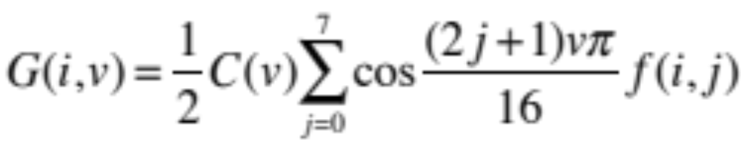

Discrete Cosine Transform (DCT)
The 2D DCT can be separated into a sequence of two, 1D DCT steps:
It is straightforward to see that this simple change savesmany arithmetic steps. The number of iterations required is reduced from 8 × 8 to 8+8.

Slide 57






2D Data Compression by DCT
DCT
original block
DCT result
Quantize result
i_DCT
Dequantize
reconstructed block
errors

Slide 58


2D Data Compression by DCT
DC component
DCT
Quantize
original image
AC components
zigzag
run-length
code
Huffman
code
10011011100011...
coded bitstream < 10 bits (0.55 bits/pixel)

Slide 59

Application on Digital Watermarking
A digital watermark is a kind of marker covertly embedded in a noise-tolerant signal and is typically used to identify ownership of the copyright of such signal.

Slide 60
Conclusion
Lossless Compression
  Run-length coding
  Prediction coding
  Huffman coding
Lossy Compression
  Transform Coding
  Discrete Cosine Transform

